Slide 1


Data Science Summit’21
Business Analysis Challenge
Team – Extra Miles

Slide 2
Team Members
Animesh Parikshya (Team Leader)
E-Mail: animeshparikshya@yahoo.in
Phone: +91 9866500604
Dr. Anshika Sharma
E-Mail: anshi1986@rediffmail.com
Phone: 9760199007
Tanisha Jain
E-Mail: tanishajainn225@gmail.com
Phone: 8859976883
Arpit Dhawan
E-Mail: glee.dhawan@gmail.com
Phone: 9950707962

Slide 3
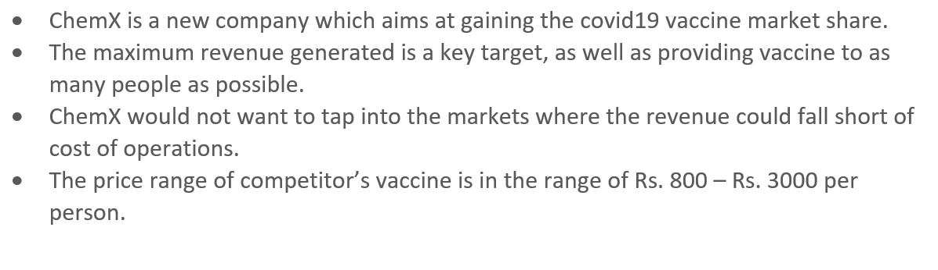
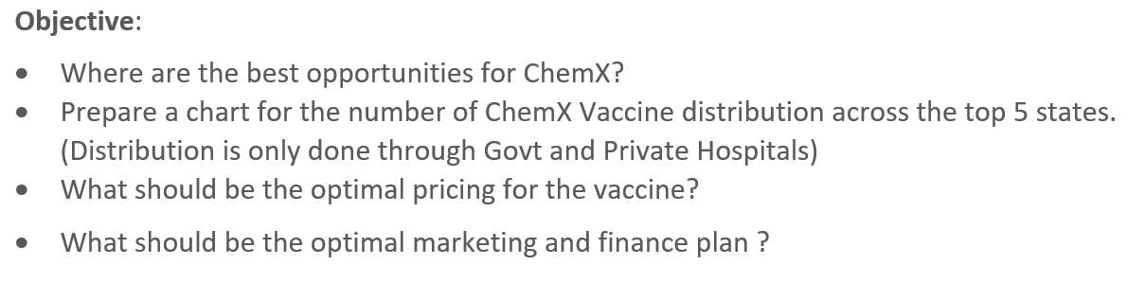
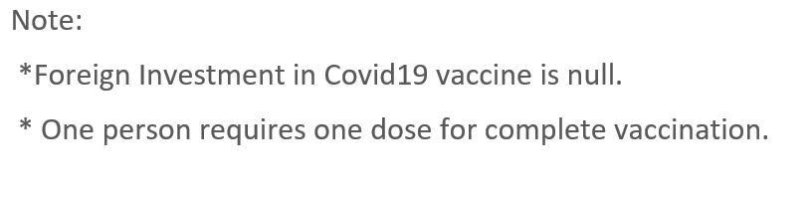
Problem Statement

Slide 4
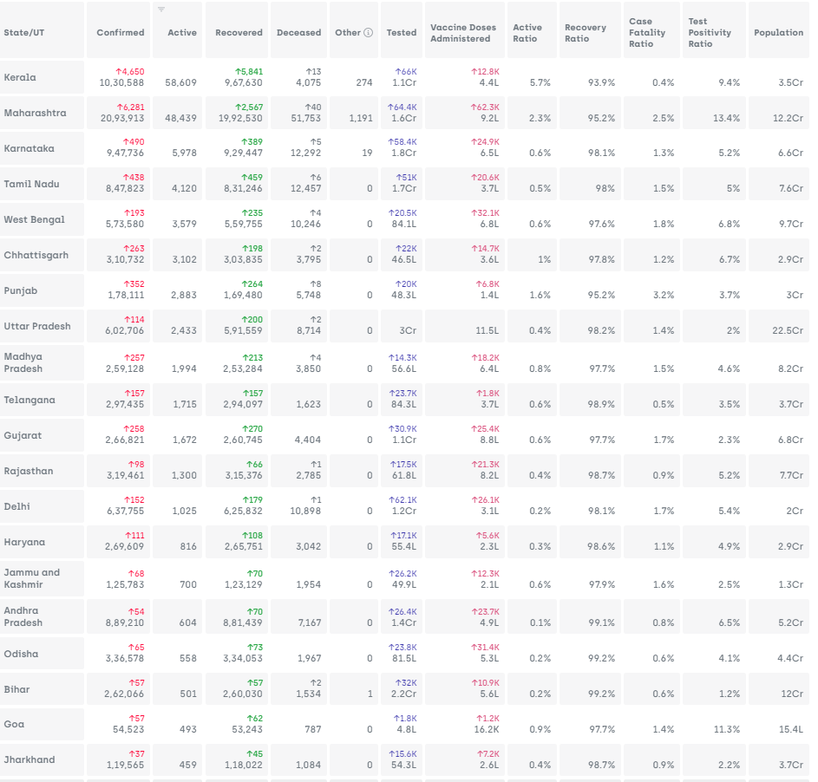
Data
Sorted at Active Cases (Ascending) as of 20-Feb-2021
Coronavirus Outbreak in India - covid19india.org

Slide 5
Solution
Where are the best opportunities for ChemX?
Answer:-
The best opportunity for ChemX will be where the number of Active
COVID-19 cases are most prevailing in INDIA. By considering the top 10
States of India (According to the data in slide 4), we can also make sure that
There will be a decrease in the operations cost.
As the population in these states are high, maximum people will be
vaccinated and it will maximize the revenue of the company

Slide 6
Solution
Prepare a chart for the number of ChemX Vaccine distribution across the top 5 states. (Distribution is only done through Govt and Private Hospitals)
Answer:- The following table and chart shows vaccine share for top 5 states as per the active
COVID-19 cases.
Covid-19 Cases
Top 5 States | Active Case | Active Case Share | Vaccine Dose to be provided
Kerala | 58,609 | 0.49 | 194190
Maharashtra | 48,439 | 0.40 | 160494
Karnataka | 5,978 | 0.05 | 19807
Tamil Nadu | 4,120 | 0.03 | 13651
West Bengal | 3,579 | 0.03 | 11858
Total |  |  | 400000

Slide 7
Solution
What should be the optimal pricing for the vaccine?
Answer:- Considering the optimal price should be average
of Market prices
Minimum Market Cost | 800
Maximum Market Cost | 3000
Average Market Cost | 1900
ChemX Cost Should be (per dose) | 1900
ChemX Profit (20%) | 380
ChemX Ops (35%) | 665
Medicine Cost (45%) | 855

Slide 8
Solution
What should be the optimal marketing and finance plan ?
Answer:-
Marketing Plan:
Collaboration with Indian Government
Sharing research and trial data to public
Doing advertisement on top 10 States
Providing Free doses to Hospital Staff
Insurance cover and compensation for any side effects
Finance Plan
Financial Goals:
Short term
Medium Term
Long Term
Budget and Cashflow planning
Insurance and Risk Management
Taxation planning
Net Worth statement – Total Asset, liabilities included
Contingency funds

Slide 9
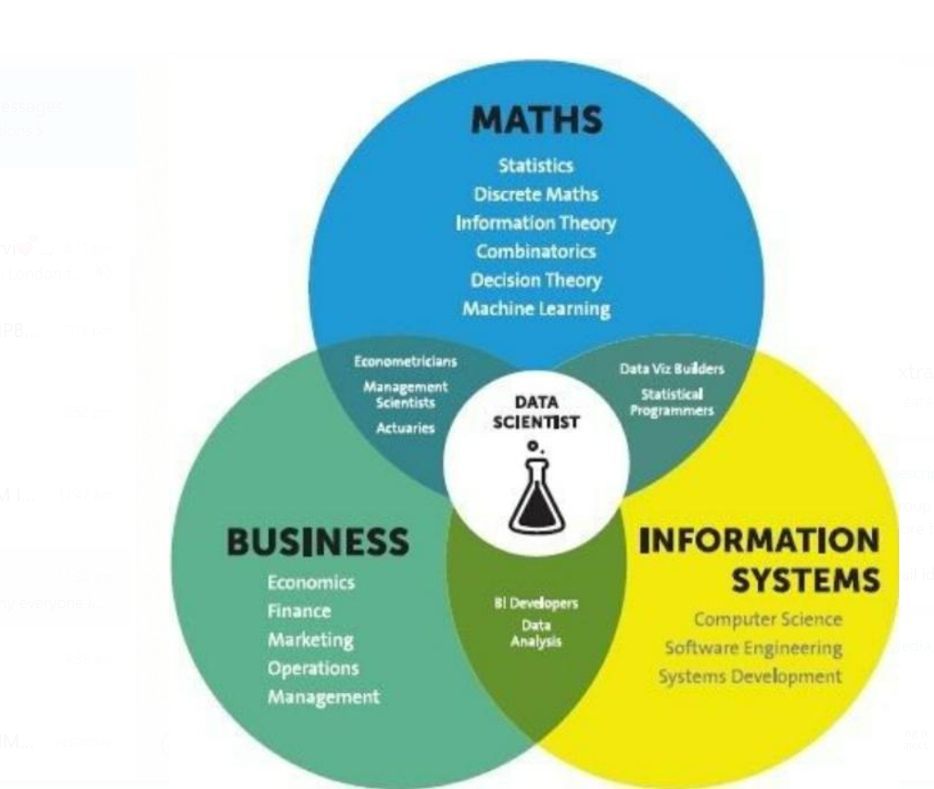

Thank You

